Slide 1



Consumer Goods Ad hoc Insights
Presenter: Vasu Bishnoi
Notes:
Hi everyone, I welcome you all to this video presentation of codebasics resume project challenge, this project is related to consumer goods domain and I have showcased my analytical skills by using sql to query data and power bi to visualise and provide insights to the top level management.
As part of project submission I am posting this presentation along with link to my github profile. Alright let us jump right in…

Slide 2

Our Company
Atliq Hardware is one of the leading computer hardware producers in India as well as 26 other countries across the globe
Manufactures products under 3 major divisions i.e., Peripherals & Accessories, PC, Networking & Storage
We have a total of 74 Customers like Neptune, Sage, Leader, Vijay Sales etc. across all markets/countries
Notes:
Hi everyone, I welcome you all to this video presentation of codebasics resume project challenge, this project is related to consumer goods domain and I have showcased my analytical skills by using sql to query data and power bi to visualise and provide insights to the top level management.
As part of project submission I am posting this presentation along with link to my github profile. Alright let us jump right in…

Slide 3

Objective
Assist the management team to gain more insights about the business
Take data-driven decisions to scale business
Notes:
Hi everyone, I welcome you all to this video presentation of codebasics resume project challenge, this project is related to consumer goods domain and I have showcased my analytical skills by using sql to query data and power bi to visualise and provide insights to the top level management.
As part of project submission I am posting this presentation along with link to my github profile. Alright let us jump right in…

Slide 4

About Data
We have 4 fact tables i.e., sales monthly, manufacturing cost, pre invoice deductions, gross price which have measurable metrics and 2 dimension table i.e., customer details and product details.
Fiscal year for Atliq Hardware starts from 1st September and ends on 31st August each year
Sales data is available for fiscal year 2020-2021
Notes:
Hi everyone, I welcome you all to this video presentation of codebasics resume project challenge, this project is related to consumer goods domain and I have showcased my analytical skills by using sql to query data and power bi to visualise and provide insights to the top level management.
As part of project submission I am posting this presentation along with link to my github profile. Alright let us jump right in…

Slide 5
Let’s see requests , query results and insights
1.Request: Provide the list of markets in which customer "Atliq Exclusive" operates its business in the APAC region.
2.Request: What is the percentage of unique product increase in 2021 vs. 2020? The final output contains these fields: unique_products_2020, unique_products_2021, percentage_chg.
3.Request: Provide a report with all the unique product counts for each segment and sort them in descending order of product counts. The final output contains 2 fields:
segment, product_count .
4.Request: Follow-up: Which segment had the most increase in unique products in 2021 vs 2020? The final output contains these fields:
segment, product_count_2020, product_count_2021, difference.
5.Request: Get the products that have the highest and lowest manufacturing costs. The final output should contain these fields:
product_code, product, manufacturing_cost .
6.Request: Generate a report which contains the top 5 customers who received an average high pre_invoice_discount_pct for the fiscal year 2021 and in the Indian market. The final output contains these fields:
customer_code, customer, average_discount_percentage. 7.Request: Get the complete report of the Gross sales amount for the customer “Atliq Exclusive” for each month. This analysis helps to get an idea of low and high-performing months and take strategic decisions. The final report contains these columns: Month, Year, Gross sales Amount.
8.Request: In which quarter of 2020, got the maximum total_quantity_sold? The final output contains these fields sorted by the total_quantity_sold:
Quarter, total_quantity_sold.
9.Request: Which channel helped to bring more gross sales in the fiscal year 2021 and the percentage of contribution? The final output contains these fields:channel, gross_sales_mln, percentage.
10.Request: Get the Top 3 products in each division that have a high total_sold_quantity in the fiscal_year 2021? The final output contains these fields: division, product_code, product, total_sold_quantity, rank_order.
Notes:
Hi everyone, I welcome you all to this video presentation of codebasics resume project challenge, this project is related to consumer goods domain and I have showcased my analytical skills by using sql to query data and power bi to visualise and provide insights to the top level management.
As part of project submission I am posting this presentation along with link to my github profile. Alright let us jump right in…

Slide 6
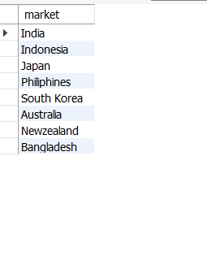
Request 1:Provide the list of markets in which customer "Atliq Exclusive" operates its business in the APAC region.
Output: 1
Query: 1
SELECT DISTINCT(market) FROM dim_customer
WHERE customer = 'Atliq Exclusive'
AND region = 'APAC';

Slide 7
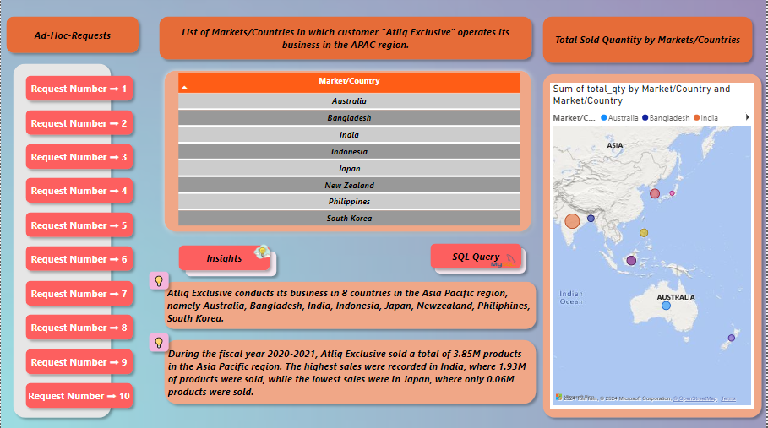
Insights
Atliq Exclusive operates its business in 8 major markets of Asia Pacific region
Atliq Exclusive has the most stores in APAC region followed by EU(6) and NA(2)

Slide 8

Request 2: What is the percentage of unique product increase in 2021 vs. 2020? The final output contains these fields: unique_products_2020, unique_products_2021, percentage_chg
Output: 2
Query: 2
WITH unique_product_count AS
(
SELECT COUNT(DISTINCT CASE WHEN fiscal_year = 2020 THEN product_code END) AS unique_products_2020,/* count of distinct/unique products sold in 2020 */
COUNT(DISTINCT CASE WHEN fiscal_year = 2021 THEN product_code END) AS unique_products_2021 /* count of distinct/unique products sold in 2021 */
FROM fact_sales_monthly
)
SELECT unique_products_2020,
unique_products_2020,
CONCAT(ROUND(((unique_products_2021-unique_products_2020)*1.0/unique_products_2020)*100,2),'%') AS percentage_chg
FROM unique_product_count;

Slide 9
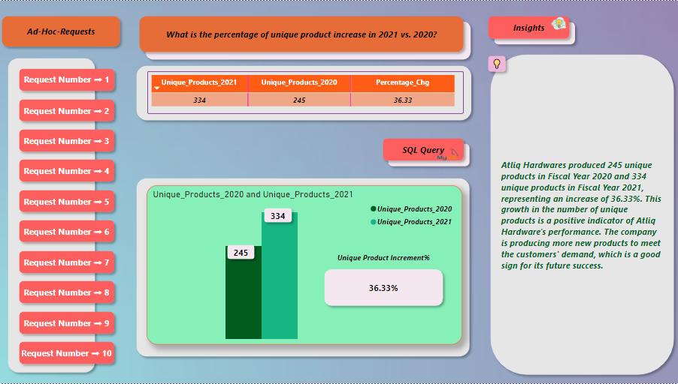
Insights
With a 36.33% increase in new products, Altiq hardware is building a strong and dynamic reputation by meeting with the changing needs of the customer

Slide 10
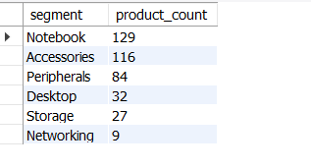
Request 3: Provide a report with all the unique product counts for each segment and sort them in descending order of product counts. The final output contains 2 fields:
segment, product_count
Query: 3
Output: 3
SELECT segment,
COUNT(DISTINCT(product_code)) AS product_count
FROM dim_product
GROUP BY segment
ORDER by product_count DESC;

Slide 11
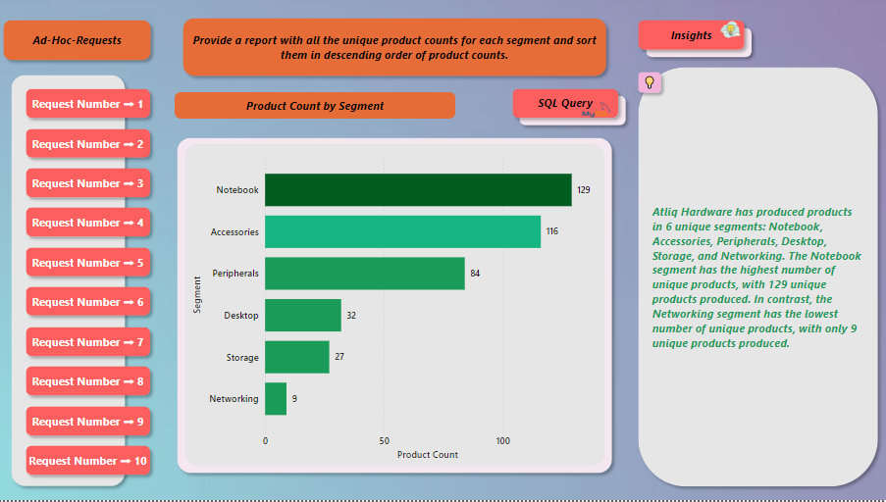
Insights
We have a wide range of products under segment: Notebook, Accessories and Peripherals averaging around 110 while segment like Desktop, Storage and Network are lagging with an average of 23 products per segment.
Product Development team needs to evaluate on products that require redesigning as per modern standards
Innovations will keep Atliq Hardware ahead in this competitive market

Slide 12
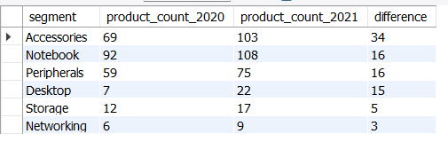
Request 4:Follow-up: Which segment had the most increase in unique products in 2021 vs 2020? The final output contains these fields:
segment, product_count_2020, product_count_2021, difference
Query: 4
Output: 4
WITH unique_product AS
(SELECT
b.segment AS segment,
COUNT(DISTINCT
(CASE
WHEN fiscal_year = 2020 THEN a.product_code END)) AS product_count_2020,
COUNT(DISTINCT
(CASE
WHEN fiscal_year = 2021 THEN a.product_code END)) AS product_count_2021
FROM fact_sales_monthly AS a
INNER JOIN dim_product AS b
ON a.product_code = b.product_code
GROUP BY b.segment)
SELECT segment, product_count_2020, product_count_2021, (product_count_2021-product_count_2020) AS difference
FROM unique_product
ORDER BY difference DESC;

Slide 13
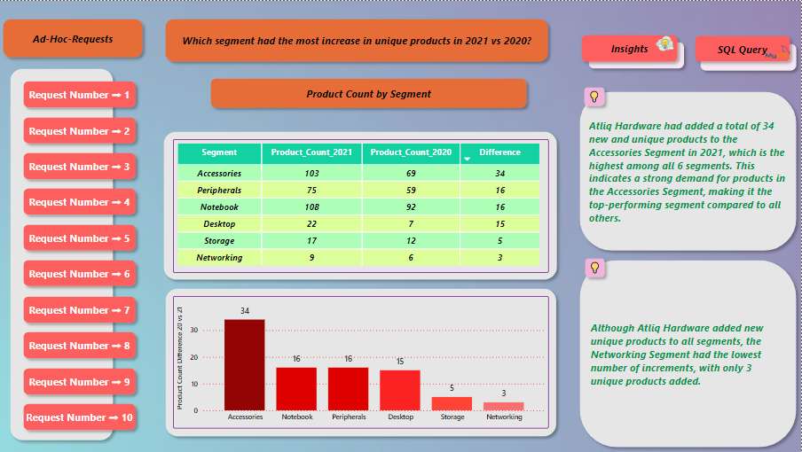
Insights
With the introduction of 34 new products, Accessories segment has the highest increase in number of unique products
Notebook and Peripherals each has an increment of 16 new unique products
Product Development team has done a good job in the Desktop segment by increasing unique products from 7 to 22
Networking segment is at the bottom with 3 new products introduced since 2020

Slide 14

Request 5: Get the products that have the highest and lowest manufacturing costs. The final output should contain these fields:
product_code, product, manufacturing_cost
Query: 5
Output: 5
SELECT a.product_code AS product_code /*here a is alias for dim_product table*/,
a.product AS product,
CONCAT('$',ROUND(b.manufacturing_cost,2)) AS manufacturing_cost /*here b is alias for fact_manufacturing_cost table*/
FROM
dim_product AS a
INNER JOIN
fact_manufacturing_cost AS b
ON a.product_code = b.product_code /* joining on key ie. product_code*/
WHERE b.manufacturing_cost = (SELECT MAX(manufacturing_cost) FROM fact_manufacturing_cost) /* filter to fetch product having max manufacturing cost*/
OR b.manufacturing_cost = (SELECT MIN(manufacturing_cost) FROM fact_manufacturing_cost) /* filter to fetch product having min manufacturing cost*/
ORDER BY b.manufacturing_cost DESC;

Slide 15
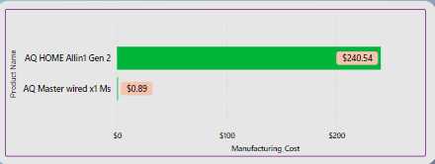



Highest manufacturing cost
Lowest manufacturing cost
AQ HOME Allin1 Gen 2 (Plus 3)
Category: Personal Desktop
AQ Master wired x1 Ms (Standard 1)
Category: Mouse
$240.54
$0.89

Slide 16
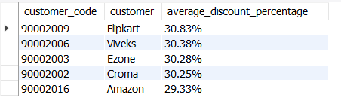
Request 6:Generate a report which contains the top 5 customers who received an average high pre_invoice_discount_pct for the fiscal year 2021 and in the Indian market. The final output contains these fields:
customer_code, customer, average_discount_percentage
Query: 6
Output: 6
SELECT a.customer_code ,
b.customer,
CONCAT(ROUND(AVG(pre_invoice_discount_pct)*100,2),'%') AS average_discount_percentage
FROM fact_pre_invoice_deductions AS a
INNER JOIN
dim_customer AS b
ON a.customer_code = b.customer_code
WHERE market = 'India'
AND fiscal_year = 2021
GROUP BY customer, customer_code
ORDER BY AVG(pre_invoice_discount_pct) DESC
LIMIT 5;

Slide 17
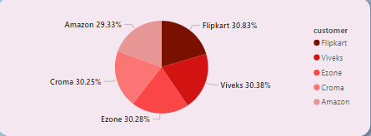
Insights
Flipkart has received the highest pre invoice discount percent i.e., 30.83%
Top 5 Customers have a collective average around 30.21%
FY 2021, Average discount provided to all customers in Indian market was 24.16%

Slide 18
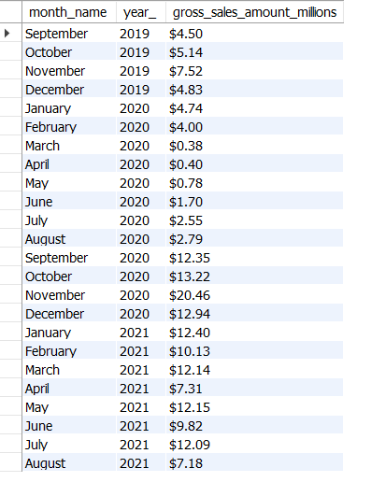
Request 7: Get the complete report of the Gross sales amount for the customer “Atliq Exclusive” for each month. This analysis helps to get an idea of low and high-performing months and take strategic decisions. The final report contains these columns: Month, Year, Gross sales Amount
Query: 7
Output: 7
SELECT
MONTHNAME(date) AS month_name,
YEAR(date) AS year_,
CONCAT('$',ROUND(SUM(a.sold_quantity * b.gross_price)/1000000,2)) AS gross_sales_amount_millions /*value in millions*/
FROM fact_sales_monthly AS a
INNER JOIN fact_gross_price AS b
ON b.product_code = a.product_code
AND b.fiscal_year = a.fiscal_year
INNER JOIN dim_customer AS c
ON c.customer_code = a.customer_code
WHERE c.customer = 'Atliq Exclusive'
GROUP BY month_name, year_
ORDER BY year_;

Slide 19
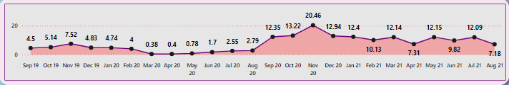
Insights
For Atliq Exclusive Store maximum sales were recorded in Nov-20 ($20.46 Million) and lowest sales recorded in Mar-20 ($0.38 Million)
Low sales from March to August were due to pandemic when stores were shut
Sales started improving from September-2020 onwards due to ease in lockdown restrictions and the onset of festival season in India and other markets

Slide 20
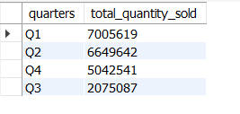
Request 8:In which quarter of 2020, got the maximum total_quantity_sold? The final output contains these fields sorted by the total_quantity_sold:
Quarter, total_quantity_sold
Query: 8
Output: 8
SELECT CASE
WHEN MONTH(date) IN (9,10,11) THEN 'Q1' /* Atliq hardware has september as it's first financial month*/
WHEN MONTH(date) IN (12,1,2) THEN 'Q2'
WHEN MONTH(date) IN (3,4,5) THEN 'Q3'
ELSE 'Q4'
END AS quarters,
SUM(sold_quantity) AS total_quantity_sold
FROM fact_sales_monthly
WHERE fiscal_year = 2020
GROUP BY quarters
ORDER BY total_quantity_sold DESC;

Slide 21
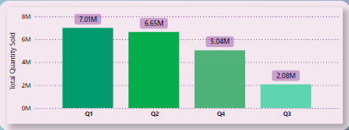
Insights
Q1( September-November) had the maximum quantity sold for FY 2020
Sales dropped in Q3( March-May) because of pandemic
Increase in sales recorded in Q4(June-August)

Slide 22
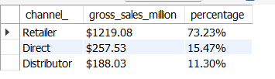
Request 9:Which channel helped to bring more gross sales in the fiscal year 2021 and the percentage of contribution? The final output contains these fields:
channel, gross_sales_mln, percentage
Query: 9
Output: 9
WITH gross_sales AS
(
SELECT c.channel AS channel_,
ROUND(SUM(b.gross_price*a.sold_quantity)/1000000,2) /* converting values to millions*/
AS gross_sales_million
FROM fact_sales_monthly AS a
LEFT JOIN fact_gross_price AS b
ON a.product_code = b.product_code
AND a.fiscal_year = b.fiscal_year
LEFT JOIN dim_customer AS c
ON
a.customer_code = c.customer_code
WHERE a.fiscal_year = 2021
GROUP BY c.channel
)
SELECT channel_,
CONCAT('$',gross_sales_million) AS gross_sales_million,
CONCAT(ROUND(gross_sales_million/ SUM(gross_sales_million) OVER()*100,2),'%') AS percentage
FROM gross_sales
ORDER BY percentage DESC;

Slide 23
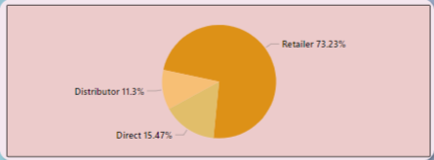
Insights
Retailers with $1219.08 Million which is 73.23% of gross sales for FY 2021 followed by Direct channel with $257.53 Million and Distributor with $188.03 Million.

Slide 24
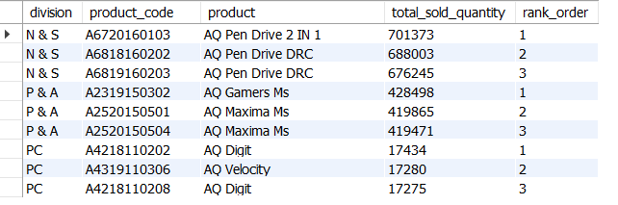
Request 10: Get the Top 3 products in each division that have a high total_sold_quantity in the fiscal_year 2021? The final output contains these fields: division, product_code, product, total_sold_quantity, rank_order
Query: 10
Output: 10
WITH top_sold_products AS /*creating a CTE for getting top selling products for all divisions*/
(
SELECT b.division AS division,
b.product_code AS product_code,
b.product AS product,
SUM(a.sold_quantity) AS total_sold_quantity
FROM fact_sales_monthly AS a
INNER JOIN dim_product AS b
ON a.product_code = b.product_code
WHERE a.fiscal_year = 2021
GROUP BY b.division, b.product_code, b.product /* to get total sold quantity we will need to group it as shown in this part of query */
ORDER BY total_sold_quantity DESC
),
top_sold_per_division AS /*creating this CTE to get top 3 based on total_sold quantity per division*/
(
SELECT division,
product_code,
product,
total_sold_quantity,
DENSE_RANK() OVER(PARTITION BY division ORDER BY total_sold_quantity DESC) AS rank_order /* using dense rank so that we can handle ties and still grab top 3 products*/
FROM top_sold_products
)
SELECT * FROM top_sold_per_division
WHERE rank_order <= 3;

Slide 25
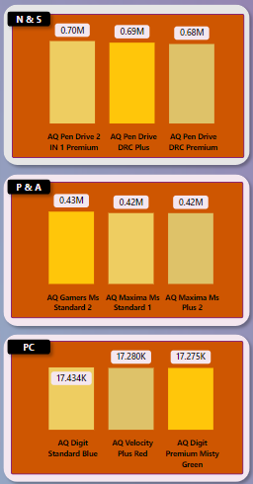
Insights
For N&S, the top selling product is AQ Pen Drive 2 IN 1 with a total of 7,01,373 quantities sold in FY 2021 followed by two variants of AQ Pen Drive DRC with 6,88,003 and 6,76,245 quantity sold respectively
For P&A, top selling product is AQ Gamers Ms with 4,28,498 quantities sold followed by two variants of AQ Maxima Ms
For PC, top selling product is AQ Digit PC with 17,434 quantities sold
The company can take some strategic decisions to improve sale in PC division

Slide 26
Thanks For Watching
Notes:
With that we have reached the end of this presentation, I would like to thank Dhaval Sir and Hemanand Sir and the codebasics team for giving an opportunity to improve our analytical skills by working on projects like these. Please feel free to give your feedback in the comment section, have a good one, thank you all, Bye!

